Slide 1

HOSTEL MANAGEMNET SYSTEM
Department of Master in Computer Application
Gandhi Institute For Technology (GIFT)
2018-21
Guided By
Asst. Prof .
Ms. Devee darshini panda
Dept. of CSE
Submitted By
Pramod kumar Barik
Regd no : T20197191

Slide 2
Contents
Introduction.
Objective of project.
Advantage of the system
Software Requirement & Hardware Requirement
List of concepts and methods used.
Reference.

Slide 3
Introduction
It is a system for managing hosteller registration book.
In this system work on the replace of traditional manual registration book .
This project main aim to computerization of the hostel management system
it is more secure to the manual registration book .

Slide 4
Introduction cont.
The project HOSTEL MANAGEMENT SYSTEM Is store all student information. like Name , phone no, father’s name , address, gender, DOB , stream ,
All the details related to a hosteller could be find in one place.

Slide 5
Objective of project
Instead of manually storing the hosteller detail , we aim to make an efficient software to do the same.
It improve efficiency of the system
This project enable to the user to store all data in a database ,and it is very easy to fetch/retrieve data from database

Slide 6
Advantage of the system
Time consuming
Secure the data
Easy to update information
Centralized database

Slide 7
Software Requirement
Build this project required software
Language : JAVA , SQL
Os : windows 10
Software : JAVA (JDK 6.0)
Tool : command prompt
Notepad
Database : oracle(SQL 10g)

Slide 8
Hardware Requirement
For build this project we are use Hardware
Processer : intel core i3(7th gen)
RAM : 6GB
ROM : 1TB
Keyboard : multimedia
But it work in minimum Hardware required
Processer : intel core i3(7th gen)
RAM : 6GB
ROM : 1TB
Keyboard : multimedia

Slide 9
List of concepts and methods used.
Here use java(jdk1.6.0) version java application for design our project .
SQL (oracle 10g ) version use for store all information in the database
Here we have compute 6 module these are LOGIN , VIEW , INSERT , DELETE, UPDATE , SEARCH
Every module are connected with database.

Slide 10
component of HMS
VIEW
.
INSERT
login
DATABASE
SEARCH
DELETE
UPDATE
[component of HMS]

Slide 11
LOGIN MODULE
lt provide authority to entering the system
Only responsible user use this system because before entering this system it required password then go to the system for uses

Slide 12
Login page

Slide 13
VIEW MODULE
It is retrieve the data from the database shown on the Interface.
It retrieve the data and with these colum name
It help us see all data which is stored in the database

Slide 14
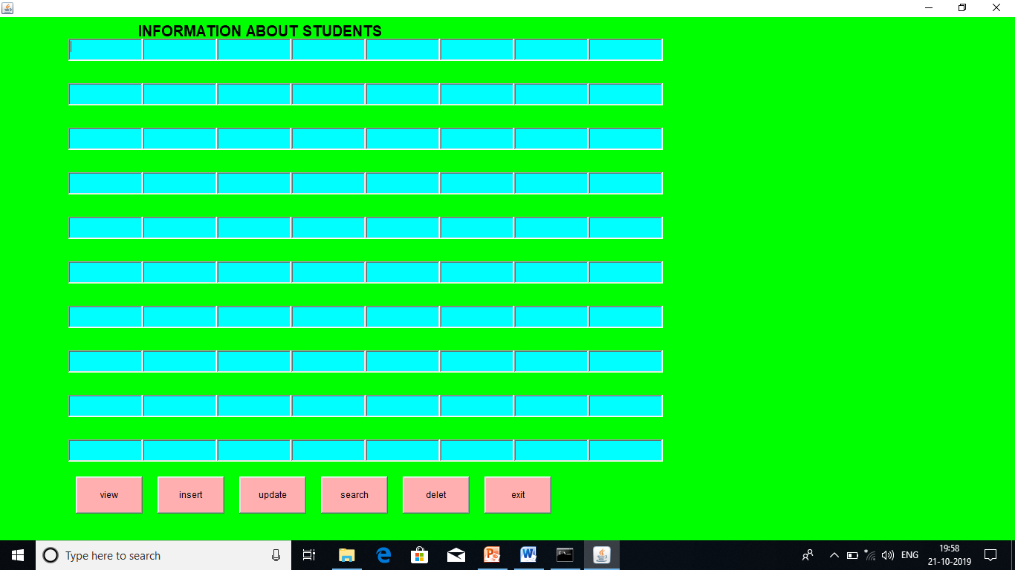
VIEW PAGE

Slide 15
INSERT MODULE
Insert module used to stored the data into database
This module provide easily stored data batter the pen and paper system
In pen amd paper system take much more time to maintain the data but it take less amount of time to maintain the data
In this module fill all detail about of student then click on submit button then store all data into data base

Slide 16
INSERT PAGE

Slide 17
UPDATE MODULE
It is used for re-edit the data ot modify the data ,
when the user mistakenly insert wrong data so that user can able to rectified or change the data

Slide 18
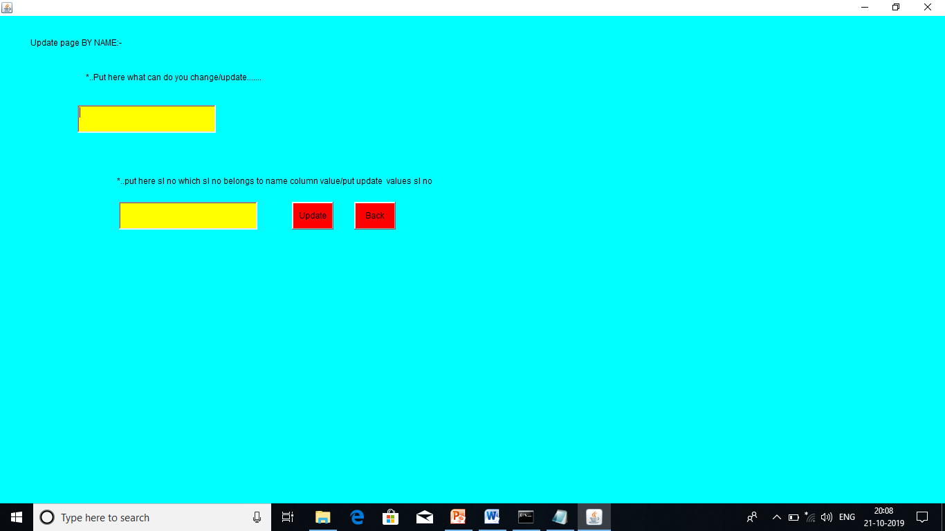
UPDATE PAGE

Slide 19
SEARCH MODULE
In the database store maximum to maximum data these time it can help them. Easily search
It easily retrieve the data from the database and shown on the interface
Here search by only name
It retrieve only one student all detail

Slide 20
SEARCH PAGE

Slide 21
DELETE MODULE
In here unnecessary data can be removed through this module
It is totally remove the data from the database

Slide 22
DELETE PAGE

Slide 23
References
We follows for build this project
Core java 10th Edition , part II , by Herbert schildt
mySQL (database system) by Narain Gehani
www.google.com
www.w3schools.com
www.mysql.com

Slide 24


